Slide 1
Ongoing Pollinator Research at EPA-ORD
Tom Purucker
purucker.tom@epa.gov

Slide 2
First few sentences of Goulson et al. 2018
Neonicotinoids are the most widely used insecticides in the world.
They are applied to a broad range of food, energy, and ornamental crops, and used in domestic pest control.
Because they are neurotoxins, they are highly toxic to insects, a group of organisms that contains the majority of the described life on Earth, and which includes numerous species of vital importance to humans such as pollinators and predators of pests.
Neonicotinoids have proved to be highly persistent in the environment, such that substantial residues are commonly found in soils, wildflowers, streams, and lakes.
One recent study found neonicotinoids in 75% of honey samples collected from around the world.
Hundreds of independent scientific studies have been performed to assess their impacts on beneficial organisms such as bees, aquatic insects, butterflies, and predatory beetles.
Goulson, D., and 232 coauthors, 2018. Call to restrict neonicotinoids. Science, 360(6392), pp.973-973.

Slide 3
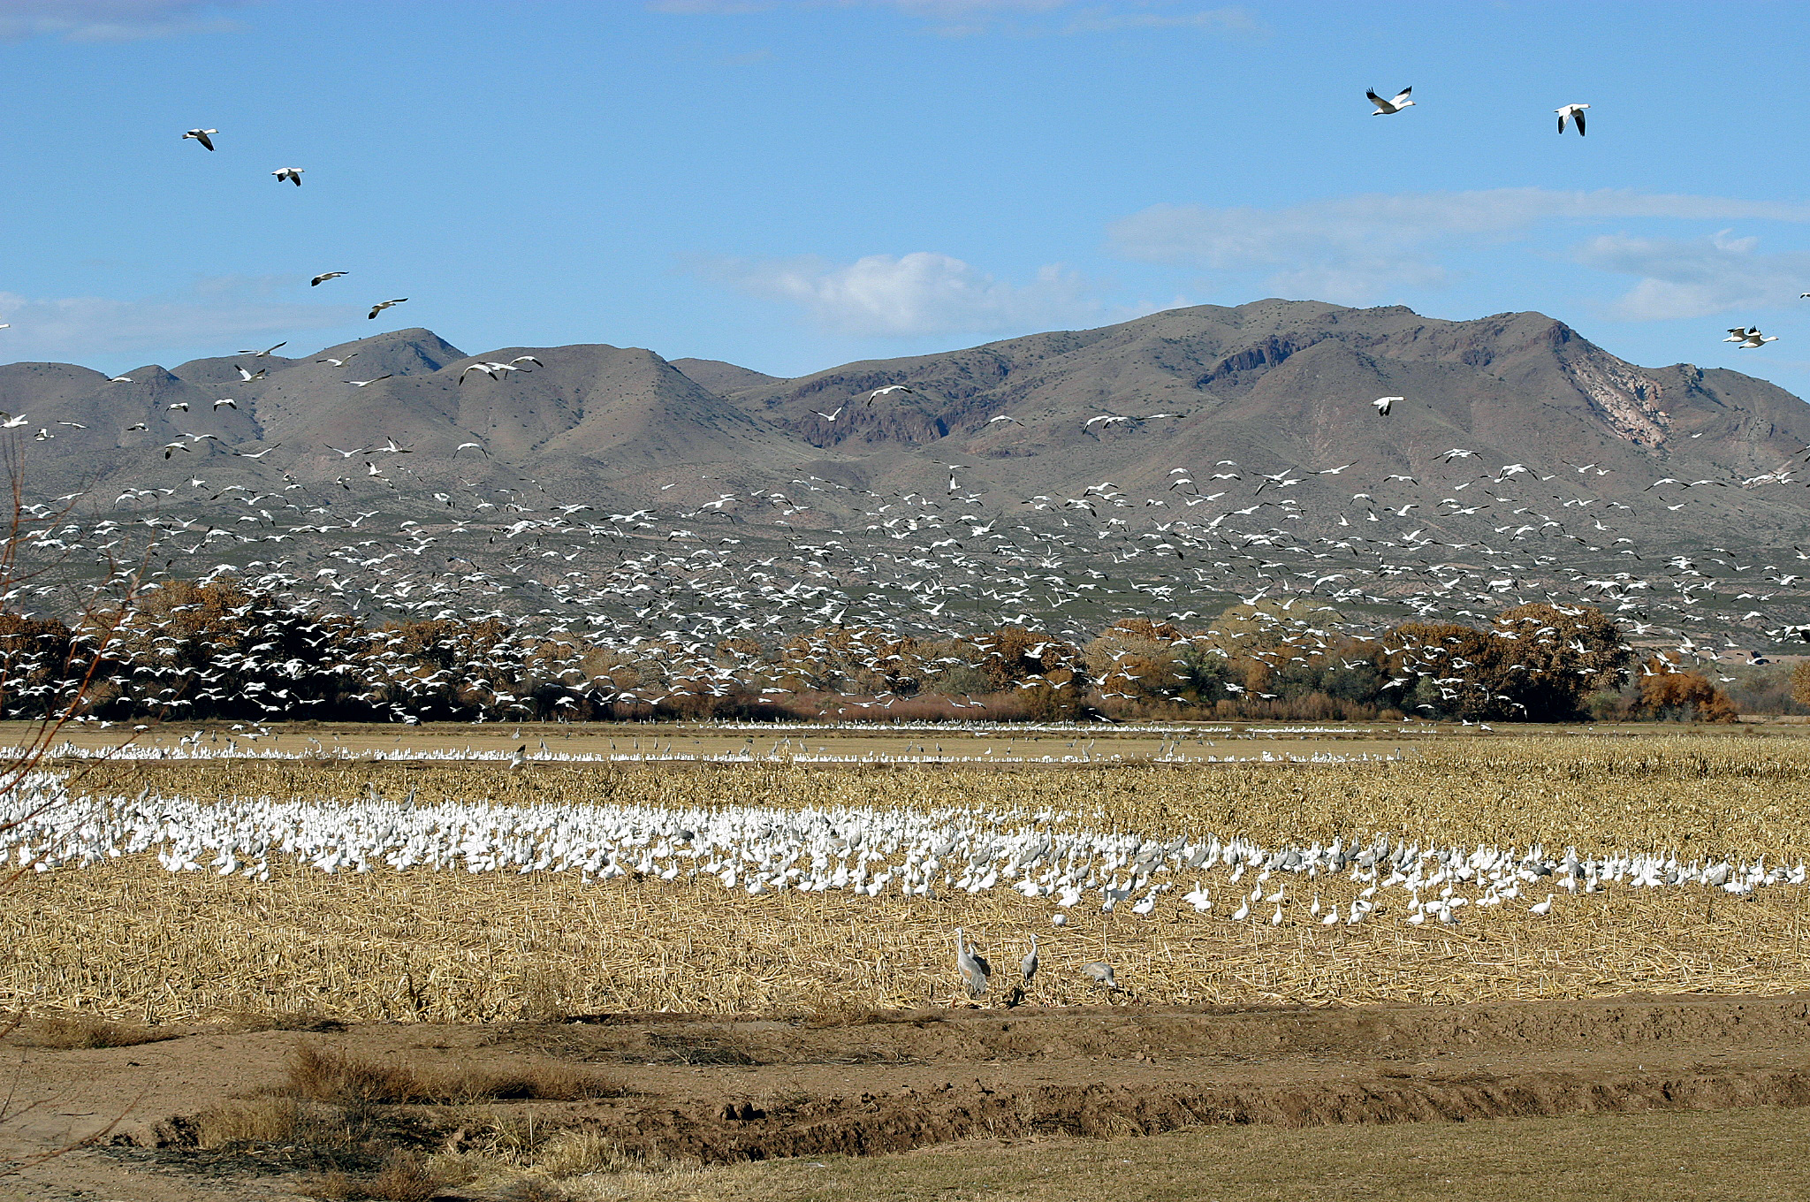

Regulation: FIFRA
Goal: Prevent . . . “unreasonable adverse effects on the environment” (FIFRA §§3[c][5] and 3[c][6]); using cost-benefit considerations. Goal could be to have no regularly repeated bird kills.
Example assessment endpoint: Bird survival.
Regulation: Endangered Species Act
Goal: Protect individual in a population. “Take” is defined by the ESA as harass, harm, pursue, hunt, shoot, wound, kill, trap, capture, or collect any threatened or endangered species. Harm may include significant habitat modification ... 7 U.S.C. § 136, 16 U.S.C. § 1531.
Example assessment endpoint: Protect individuals in the identified population.

Slide 4
Pesticide use patterns have changed
Pesticide use patterns evolve, searching for more effective, targeted insecticides, with less nontargeted effects.
Over the past 10-15 years, neonicotinoids have essentially replaced organophosphates and carbamates as a primary insecticide.
Neonics are more effective as a neurotoxin against insects--but also lower relative risks for human workers (and other vertebrate species) relative to organophosphates/carbamates.
Flexible application methods (e.g., seed coatings).
Lower evolution of resistance (so far).

Slide 5
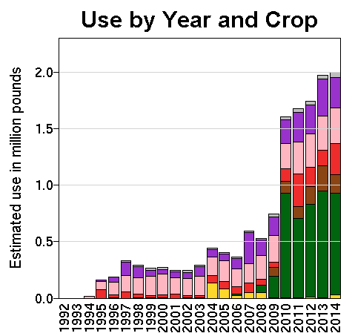
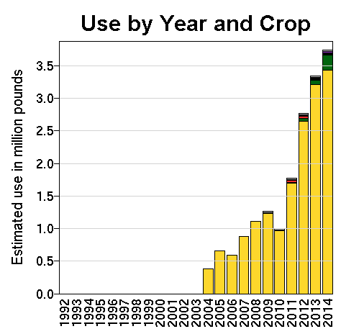
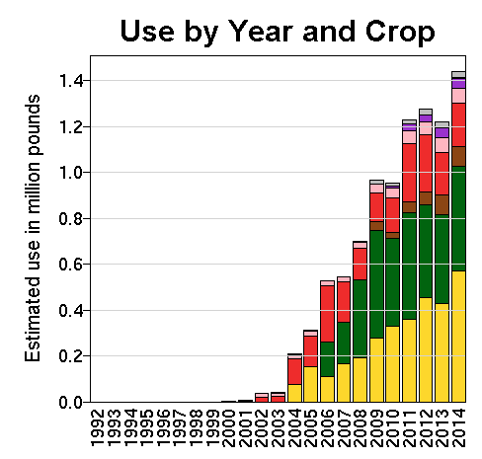
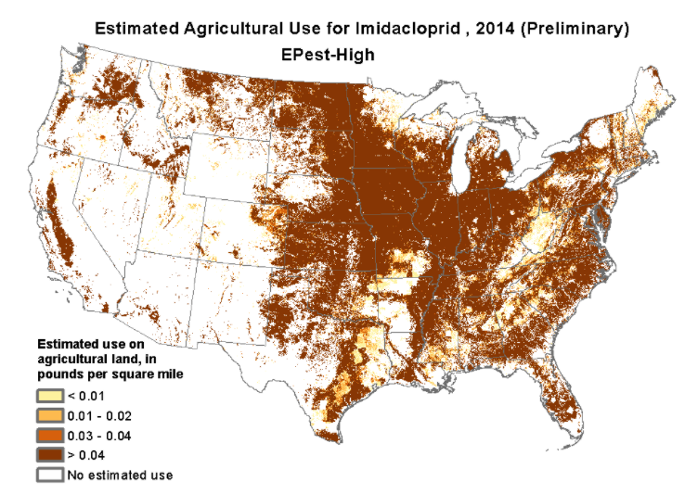
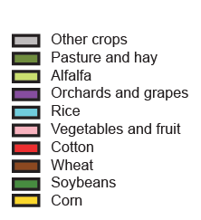
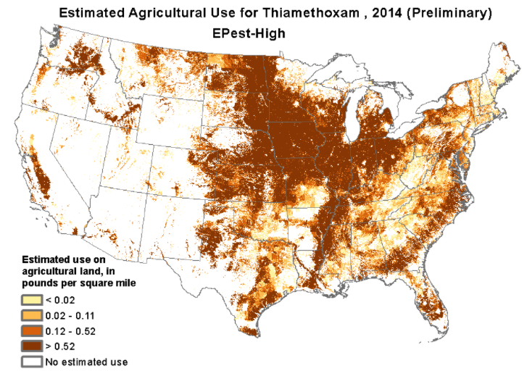
Thiamethoxam
Imidacloprid
Clothianidin

Slide 6
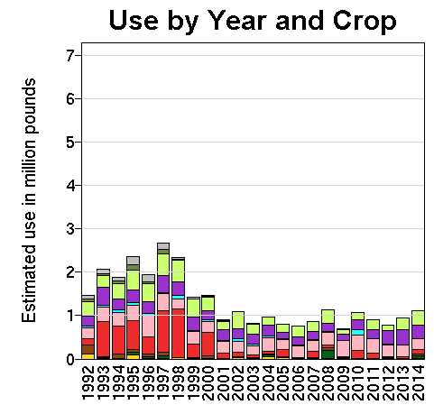
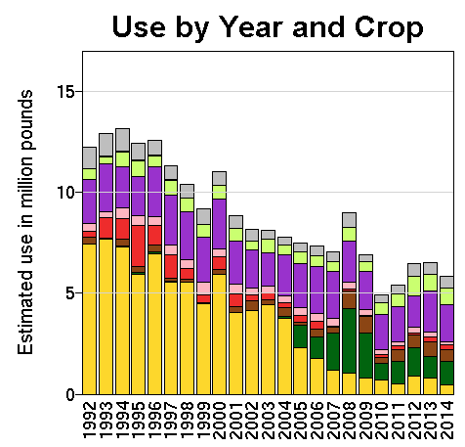
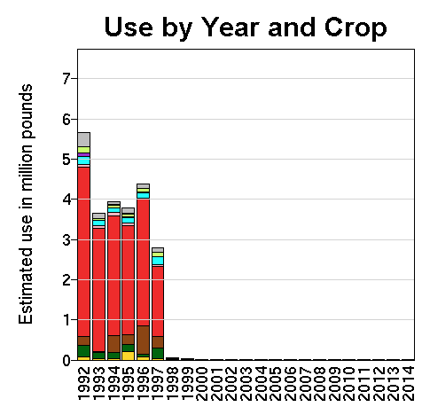
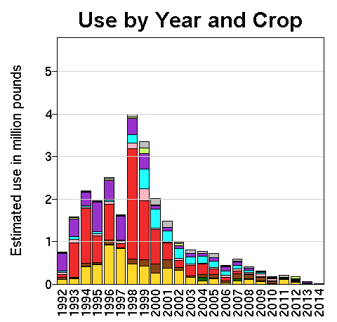
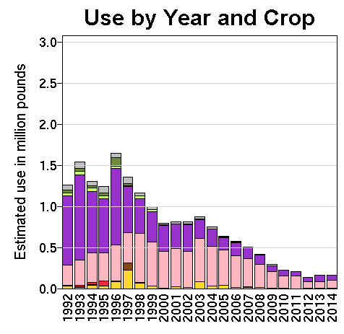
Neonicotinids vs Organophosphates/ Carbamates
Parathion
Malathion
Chlorpyrifos
Methyl Parathion
Diazinon

Slide 7
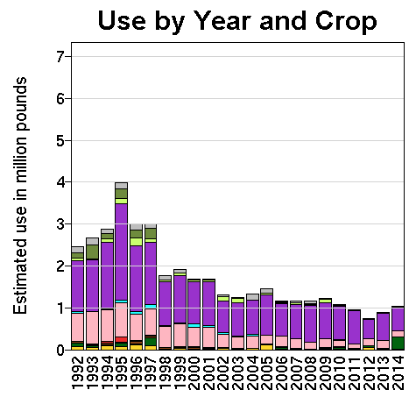
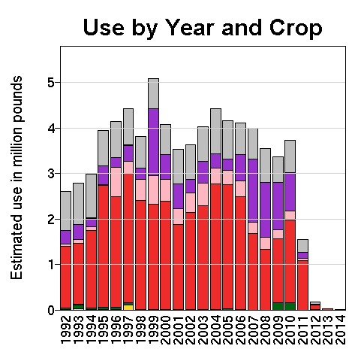
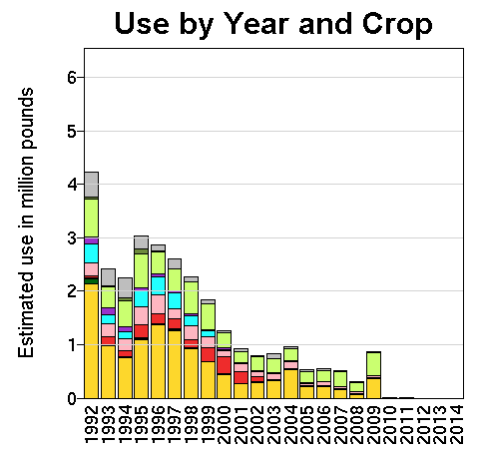
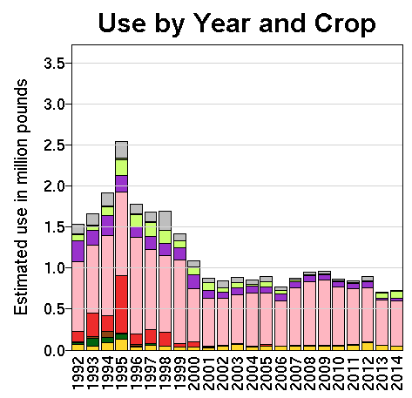
Neonicotinids vs Organophosphates/ Carbamates
Carbaryl
Aldicarb
Carbofuran
Methomyl

Slide 8
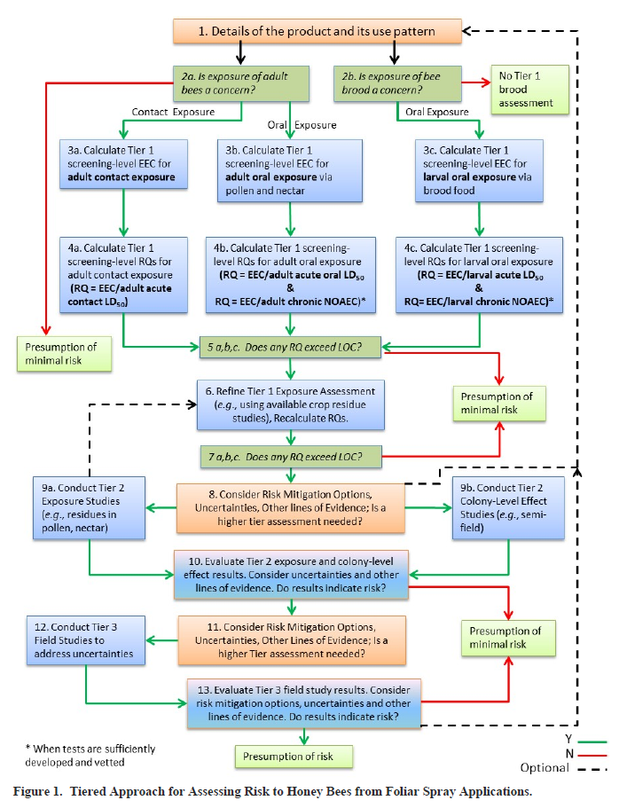
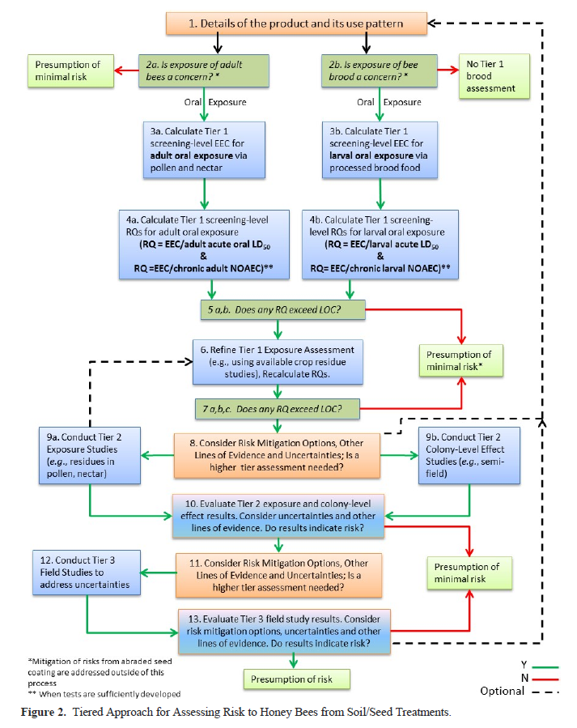

Slide 9
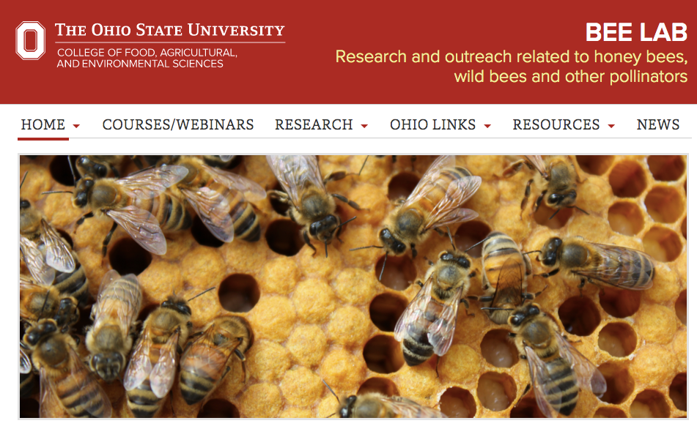
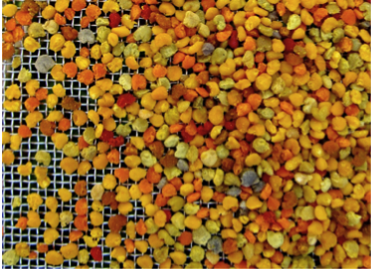
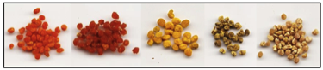
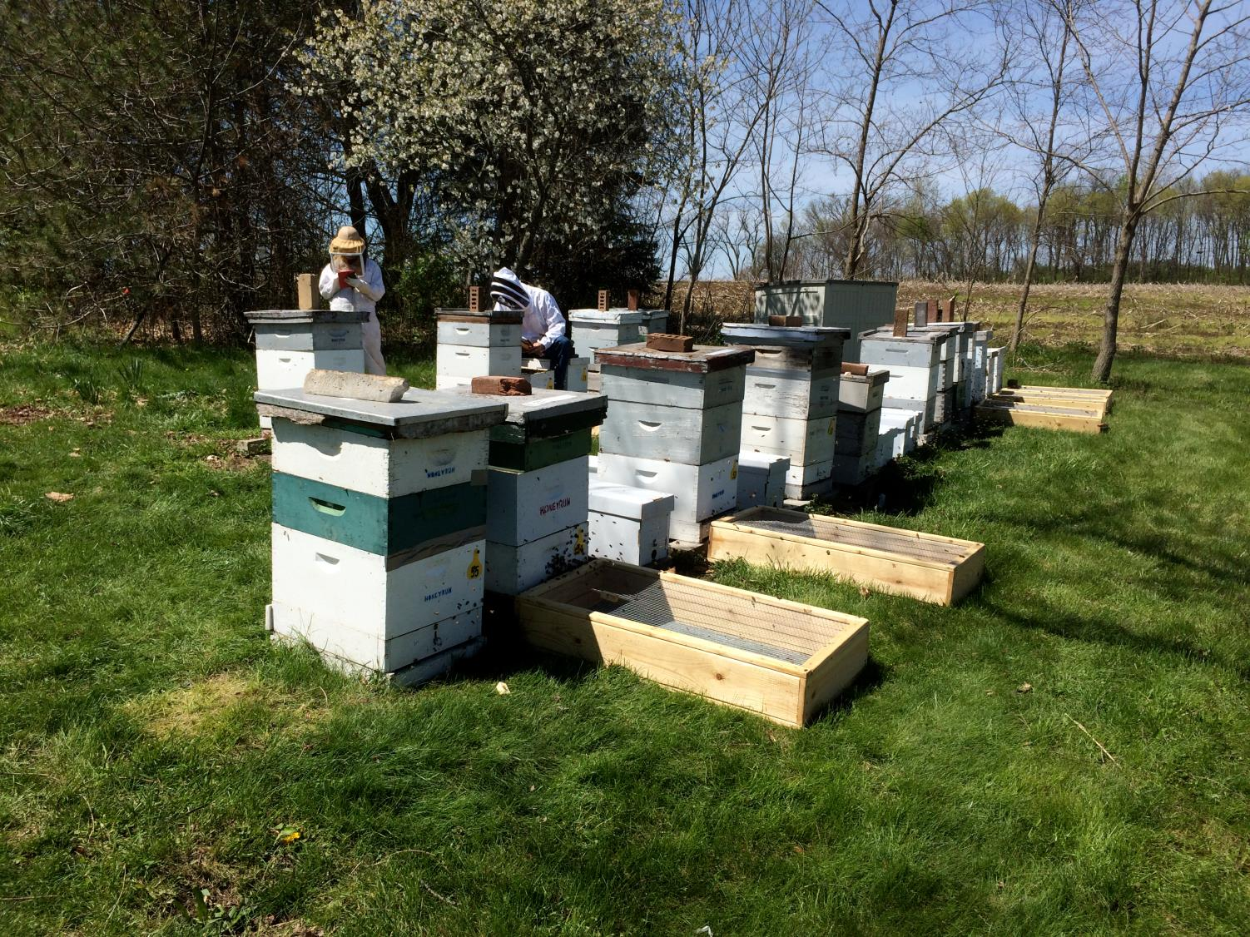
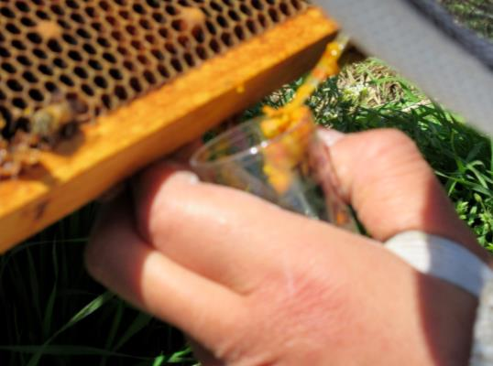


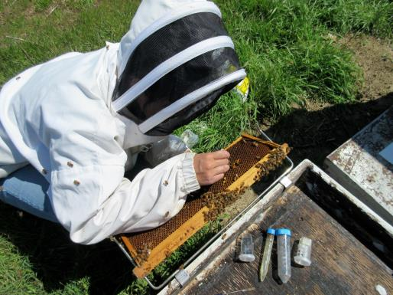
Quantified field concentrations of neonics
Field component – neonic concentrations in exposure media
Collect pollen, dead bees, bee bread, nectar, larvae from apiaries during corn planting
Collect basic data on colonies for use in modeling
Lab component -- closed nuc study
Test effects of relevant exposure levels on nurse bees and larvae
Examine movement and degradation in hive-like conditions

Slide 10
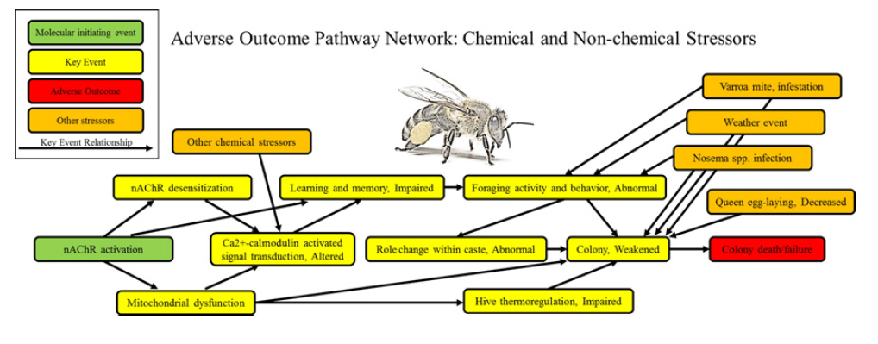
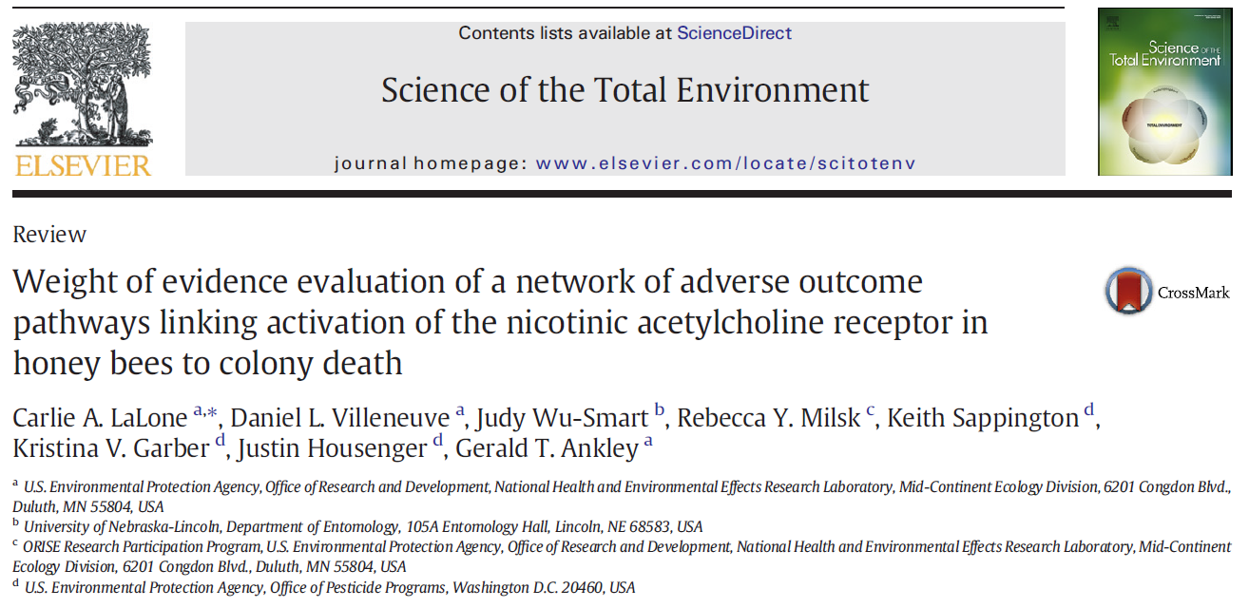
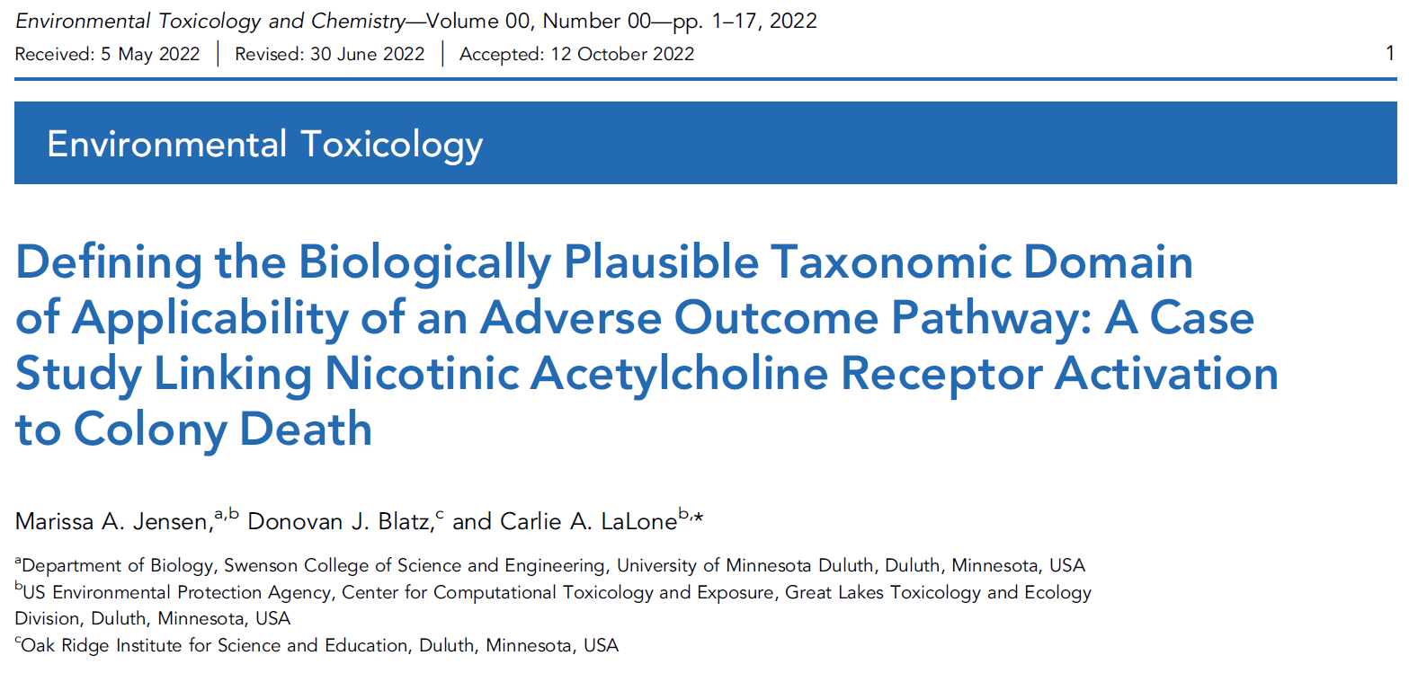
Described how pesticides impact the nicotinic acetylcholine receptor AOP network
Establishing the mode of action of the pesticide is an important part of the regulatory process.

Slide 11
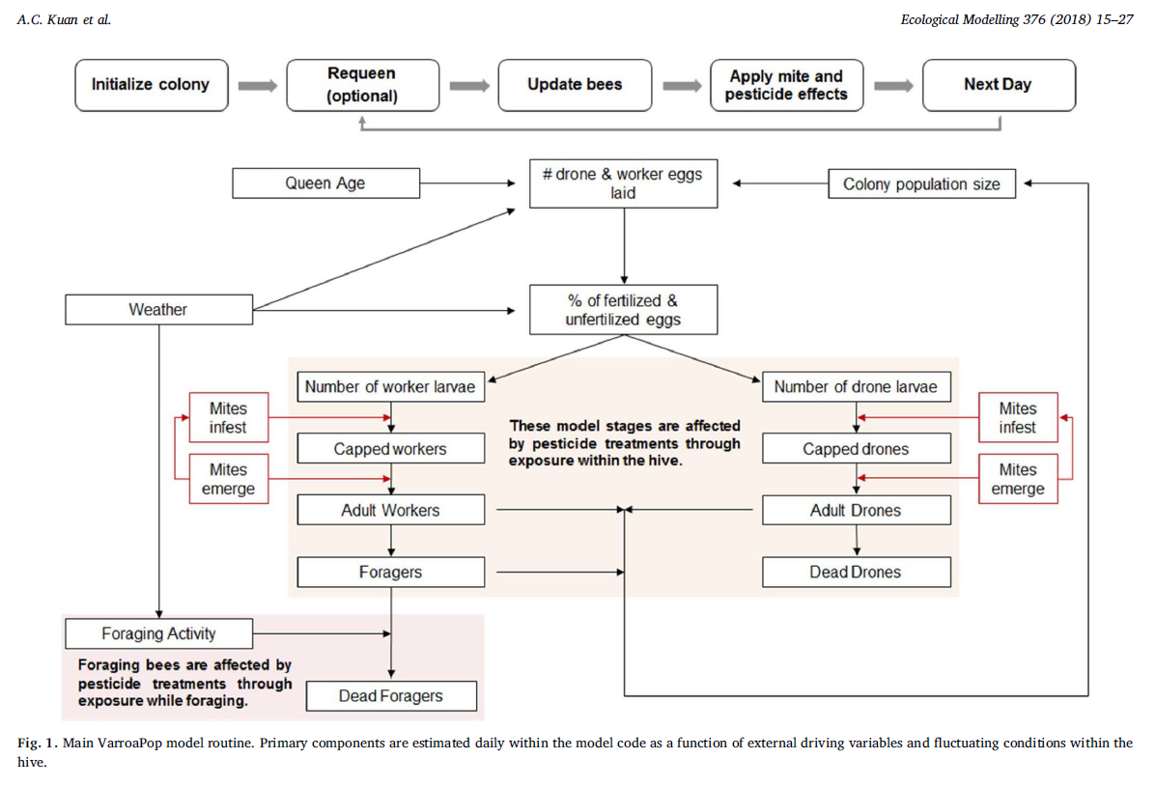
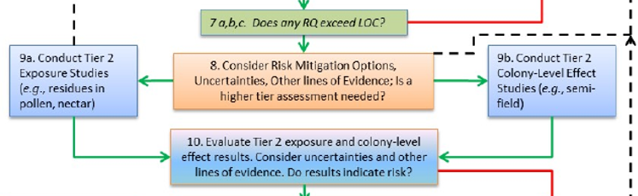
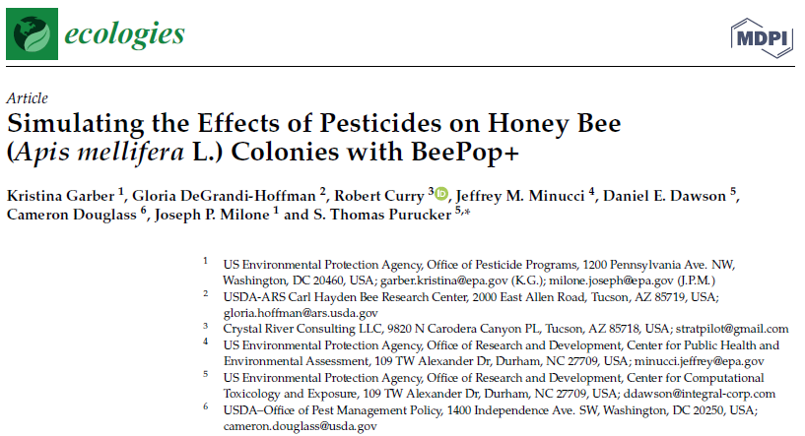
Modified an existing USDA model for colony simulations
We have worked with USDA and OPP/EFED scientists to modify an existing colony simulation model (Varroapop) to account for pesticide exposure and risk.

Slide 12
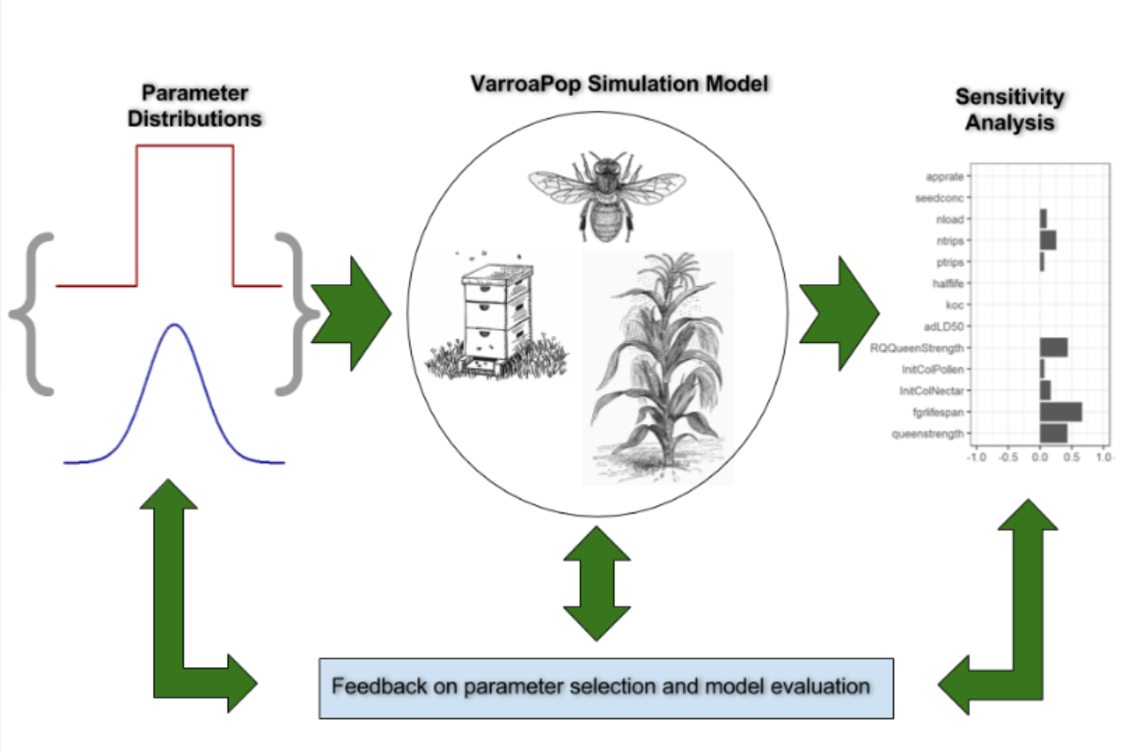
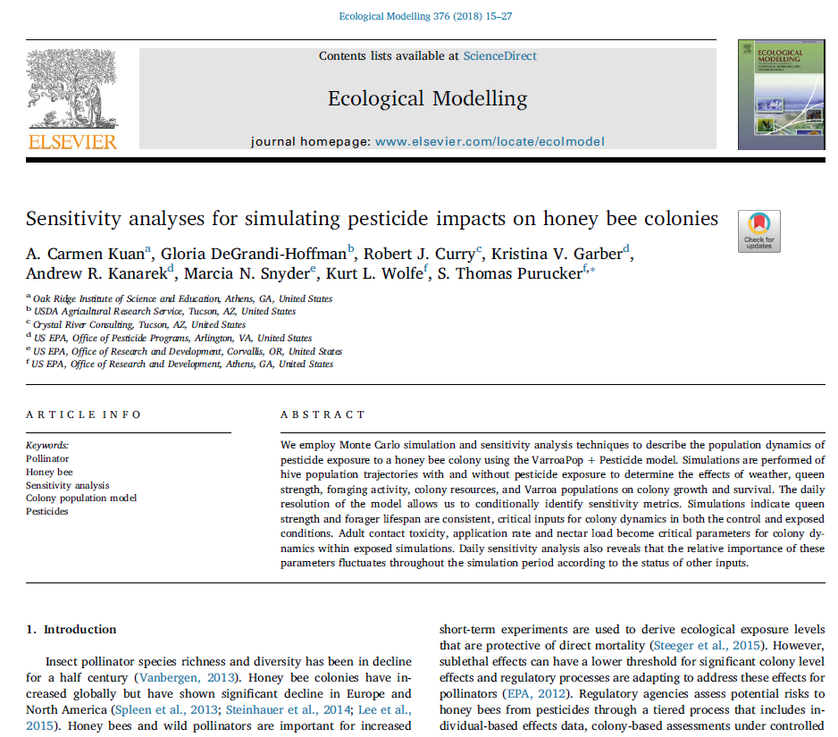

Ran Monte Carlo and sensitivity analyses on the updated model

Slide 13
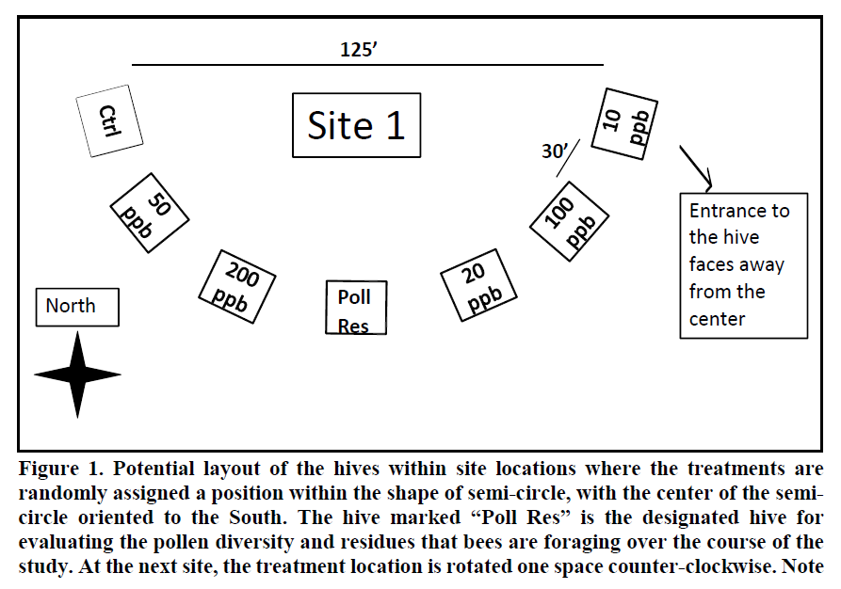
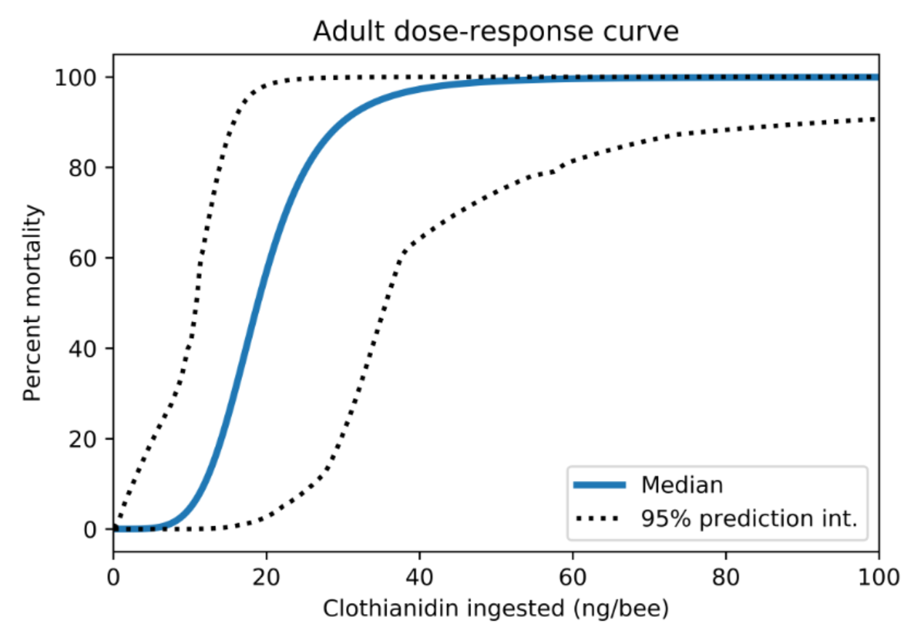
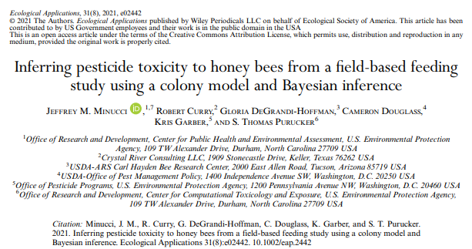
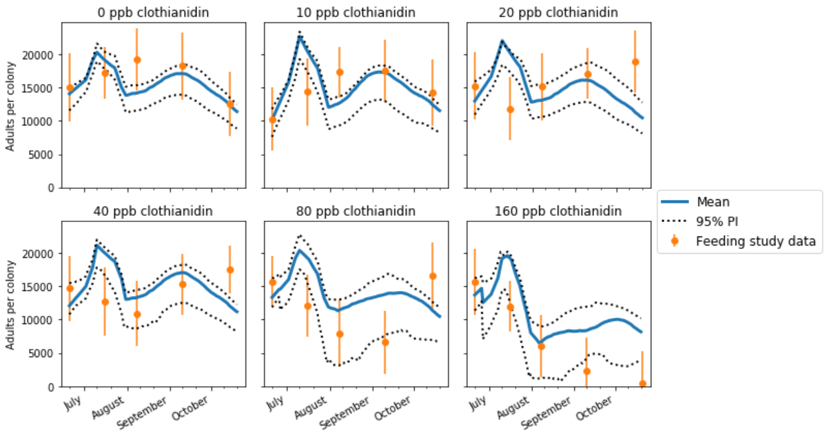

Inferred honey bee toxicity from colony studies

Slide 15
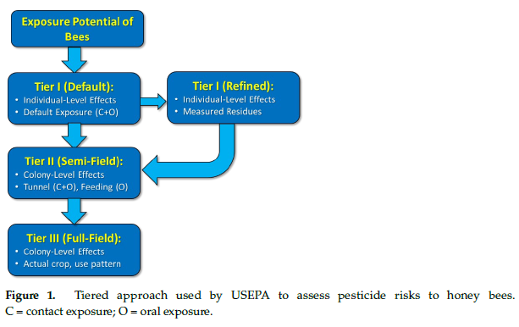
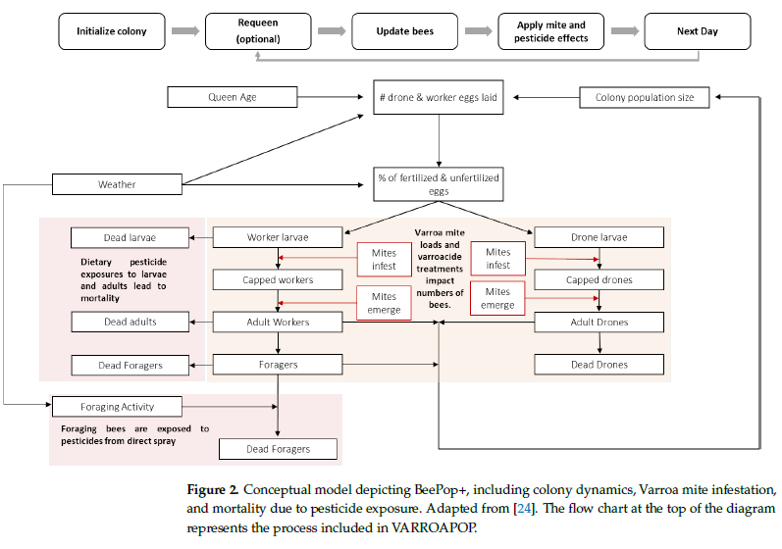
Published the updated honey bee colony code

Slide 16
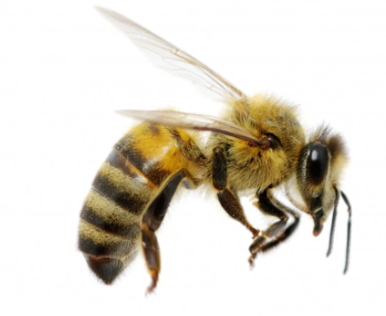
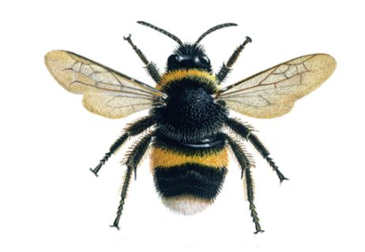
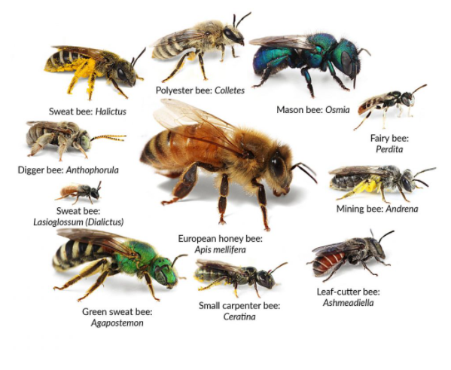
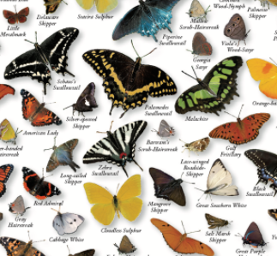
Planned Research
Primary focus of recent research has been on honey bees due to pollination services
Explicit goal of current research is to continue that work but also to broaden to non-Apis pollinators (particularly endangered species)

Slide 17
Current Research Plan
DESCRIPTION: Pollinator assessments are a key aspect of Agency ecological risk assessments, and honey bees continue to be used as a surrogate for other species of bees. A tiered approach using Tier 1 testing and modeling (e.g., the colony simulation model) is proposed to determine the need for additional tier testing. In addition, methods are needed to identify exposure to other species of bees in areas where honey bees are not a suitable surrogate. Furthermore, an examination is needed to determine the relative sensitivity/toxicity of honey bees to non-Apis bees, as well as other insect pollinators (e.g., butterflies). Lastly, work under this Output may also include investigation to understand potential linkages between declines in pollinators and the impacts to plants covered by the Endangered Species Act.

Slide 18
Planned Pollinator Research 2022-2026
OPP providing registrant data for bee studies from multiple species for species sensitivity distributions (also pollen residue data)
Developing exposure/effect models for non-Apis bee species (e.g., Rusty patched bumble bee) for endangered species effects assessments
Hummingbird exposure/effects
High throughput toxicokinetic models which estimate fate of neonicotinoids within the invertebrate (esp. the brain)
Great Lakes study with FWS, spatial analysis to guide habitat modifications/improvements for the RPBB
Omics applications (Transcriptomics, Metabolomics, NTA)

